Slide 1
Evolution of Complexity COMP6202
Richard A. Watson
Agents Interaction and Complexity (AIC)

Slide 2
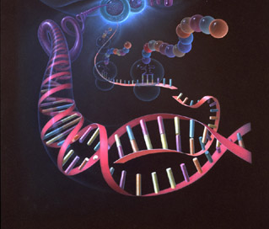


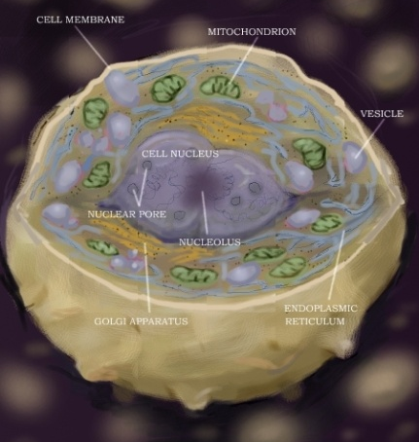
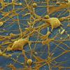
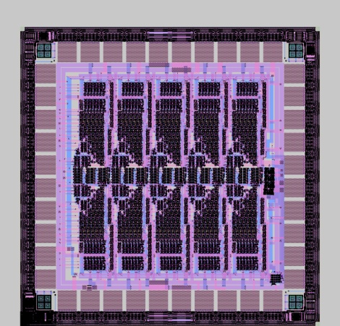
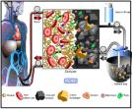
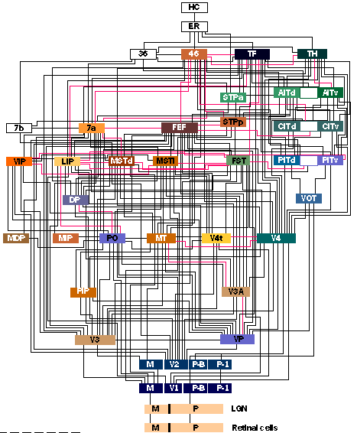
Complexity of engineered things vs living things
yb = YResolution-1;
vsa_set_clip_mode(1);
vsa_set_viewport(xl,yt,xr,yb);
num_lines = 4000;
srand(1);
for(i=0;i<num_lines;i++)
{
x[i] = ((unsigned long)(XResolution-1)*rand())/RAND_MAX;
y[i] = ((unsigned long)(YResolution-1)*rand())/RAND_MAX;
}
vsa_set_color(6);
vsa_move_to(0,0);
clk = clock();
for(i=0;i<num_lines;i++)
vsa_line_to(x[i],y[i]);
delta = clock() - clk;
timer = ((float)(delta))/((float)CLOCKS_PER_SEC);
if(timer == 0) timer = .000001;
sprintf(text,"elapsed line drawing time = %f sec\n",timer);
vsa_write_string(10,10,15,text);
sprintf(text,"RANDOM LINES: Drawing Rate = %f lines/sec\n",num_lines/timer);
vsa_write_string(10,25,15,text);
if(getch() == 27)
goto BAIL;
goto LOOP;
BAIL:
vsa_init(3);
return;
}

Slide 3
Evolution of complexity
Bio-complexity is evolved →
Study processes and mechanisms of natural evolution and the factors affecting evolvability of complex systems →
Algorithms and techniques of automatic design, engineering and optimisation inspired by natural evolution.
Evolutionary algorithms, genetic algorithms, etc.

Slide 4
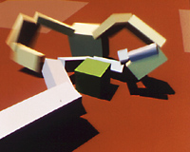
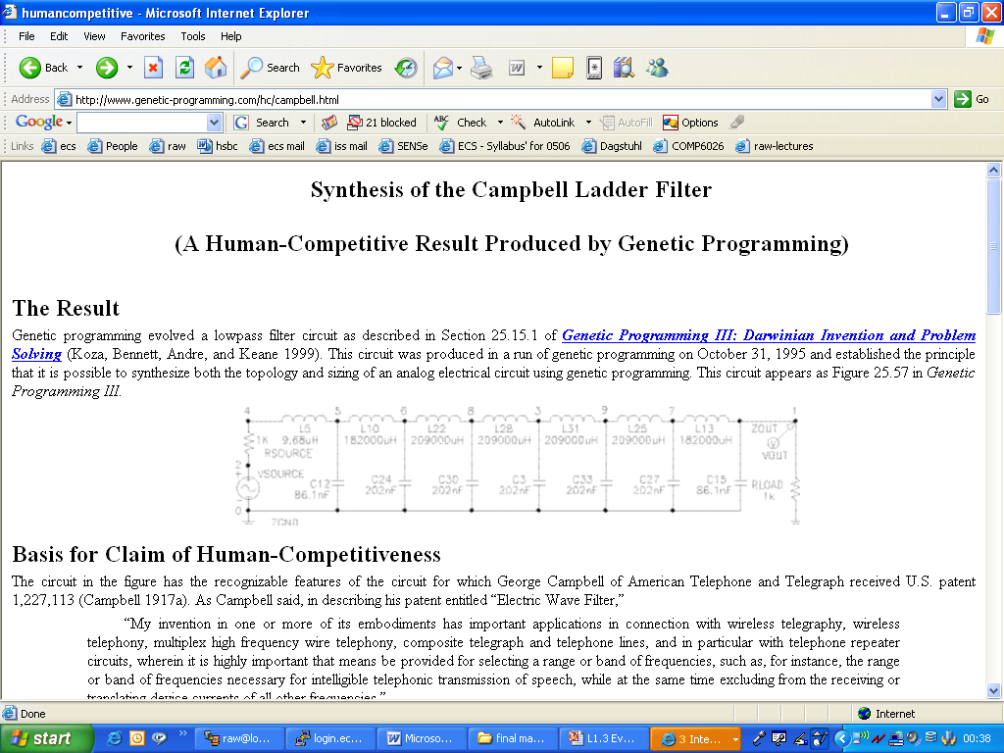
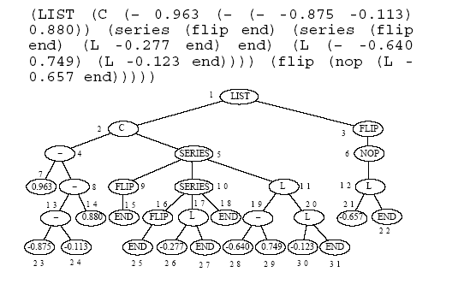
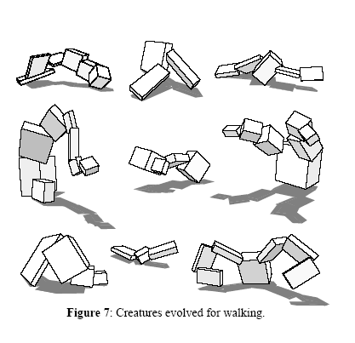
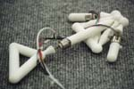
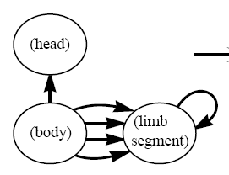
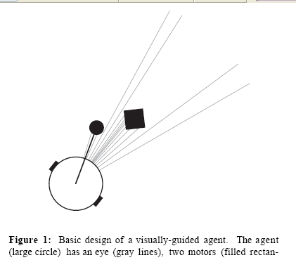
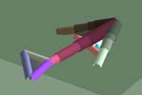
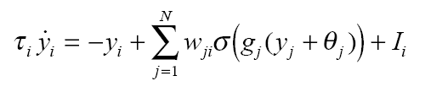
Artificially evolved complexity

Slide 5
Big questions
Does what we understand about evolution by natural selection explain an increase in complexity/ what limits increases in complexity?
Is Darwinian algorithm of evolution complete/sufficient?
How do biological processes like sex, coevolution, symbiosis affect evolution?
Can engineering concepts like modularity and top-down design be exploited in artificial evolution?

Slide 6
Overview for today
Me, you
Course aims, objectives
Where to get more info: syllabus, notes, books
Delivery
Lecture outline
Assessment methods
Labs, reading, labs, how to contact me, how I contact you
Status of “evolution the theory”
What is evolution by natural selection?
Methinks it is like a weasel (assignment 1)

Slide 7
Me: Richard A. Watson
B.A. Computing with Artificial Intelligence, Sussex, 1990
British Telecommunications Software Engineer, -1992
Goofing off in Australia -1995
MSc, Knowledge Based Systems, Sussex, -1996
PhD, Brandeis University (Boston USA), -2002
“Compositional Evolution: Interdisciplinary Investigations in Evolvability, Modularity, and Symbiosis”
Post-doctoral research fellow, Organismic and Evolutionary Biology, Harvard University, -2004
Senior Lecturer, Agents Interaction and Complexity, Southampton University, 2004-
Evolutionary computation, theoretical evolutionary biology

Slide 8
You
MSc Artificial Intelligence students
Part IV MEng students
Computer Science, Computer Science with Artificial Intelligence, Electronic Engineering, Electronic Engineering with CS, Digital Systems Engineering
Pre-requisites
You must be able to program.
You must be mathematically adept.
This unit introduces basic biological topics to a computer science/numerate audience and assumes no biological background/pre-requisites.
Your Status?
Enrolled already
Shopping
‘Sitting in’

Slide 9
Course aims, objectives
To provide knowledge of the theory, mechanisms and processes of evolution, and the factors affecting evolvability of complex systems, paying particular attention to the algorithmic assumptions underlying different aspects of the models and theory.
To provide knowledge of and experience with using computational methods inspired by natural evolution and population dynamics.
To place this knowledge and these techniques within the broader framework of general computational optimization techniques.

Slide 10
Where to get more info: syllabus, notes, books
https://secure.ecs.soton.ac.uk/notes/comp6202/
http://www.ecs.soton.ac.uk/syllabus/comp6202.html

Slide 11
Delivery
Lecture outline
Guest lecturers on contextual topics
Assignments
Reading (set reading and texts)
De Jong, KA, 2002, Evolutionary Computation: A Unified Approach.
Ridley, M., 2003. Evolution (3rd edition). [the textbook].
Michalewicz & Fogel, 2004. How to Solve It: Modern Heuristics.
Kauffman, 1993, The Origins of Order.
Updates: on course pages, email
Class participation

Slide 12
Assessment methods
50% exam
1x 1hr (90 mins) exam
50% coursework
one assessed assignment
Assignments
(1 Basic evolutionary algorithm)
Assignment 2: 50%
Re-implement a paper from the list given
Extend as you like using any technique you’ve seen in the course

Slide 13
Status of “evolution the theory”
Evolution by natural selection is a scientific theory
It’s the best explanation available for the complexity of living things
It’s not perfect
It’s your duty as a scientist to find holes in it
However, if you have any inclination to substitute the supernatural as an alternative ‘explanation’ …that is not the business of this class

Slide 14
What is evolution by natural selection?
How does evolution work?
What does ‘survival of the fittest’ mean?

Slide 15
Evolution by natural selection
Evolution
Change in (the genetic make-up of) a population
e.g. by natural selection
Components required for natural selection
Reproduction (multiplication)
Heredity (offspring are like parents)
Variation (individuals are different from one another)
Heritable fitness variation (some of that variation is heritable and affects fitness)
What is fitness?
Can being weedy, nerdy and un-athletic be ‘high fitness’?
Can being altruistic be ‘high fitness’?
Heritable variation in reproductive success

Slide 16
Reading
Evolution, Ridley, Ch 4, Natural Selection By week 2 you must be able to answer questions 2 and 3 in the 'study and review questions'

Slide 17
Discussion
Is the complexity of biological systems greater now than it was at the origin of life on earth?
Would that have happened without evolution by natural selection?
Does evolution produce a pressure toward increasing complexity?
Is evolution by natural selection responsible for the origin of life? – the transition from non-living to living
Crystals can make copies of themselves=‘reproduce’ their structure. Why don’t crystals evolve?

Slide 18
Hamlet: Act 3, Scene 2 (end of)
HAMLET + LORD POLONIUS
Do you see yonder cloud that's almost in shape of a camel?
By the mass, and 'tis like a camel, indeed.
Methinks it is like a weasel.
It is backed like a weasel.
Or like a whale?
Very like a whale.
(what are the chances of a cloud that looks like a weasel?)

Slide 19
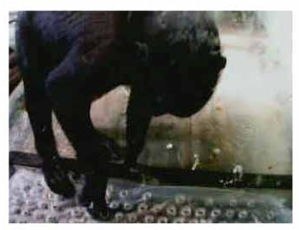
Monkeys + typewriters
Enough monkeys, on enough typewriters, given enough time, will write a Shakespeare play
http://www.vivaria.net/experiments/notes/documentation/

Slide 20
How much time?
Evolution depends on random chance mutations, how could the eye, the human brain, a bumble bee, arise by chance?
“Methinks it is like a weasel”
28 chars
Suppose a typewriter with 27 keys (26 letters + space)
Number of possible sentences
= 27 ²⁸ = 10 ⁴⁰
Only one of which is the sentence we want
At 1 sentence per second, that’s 10⁴⁰ seconds to try them all…
= 10 ³² years = 10 ²² universe-lifetimes

Slide 21
Now try it with selection
Get 100 monkey ‘sentences’
Score the sentences according to how close they are to “Methinks it is like a weasel”
Discard the worst half
From the remainder create 100 ‘monkey-modifications’
Richard Dawkins: The Blind Watchmaker
http://home.pacbell.net/s-max/scott/weasel.html
(assignment 1)

